Slide 1

Customer Shopping Behavior Analysis
Uncovering insights from 3,900 purchases to guide strategic business decisions

Slide 2

PROJECT OVERVIEW
Understanding Customer Patterns
Analysis of transactional data across various product categories to uncover spending patterns, customer segments, product preferences, and subscription behavior.
3.9K
18
Total Purchases
Data Points
Transactions analyzed
Features tracked
4
Categories
Product types

Slide 3


DATASET
Data Foundation
Demographics
Purchase Details
Age, Gender, Location
Item, Category, Amount
Subscription Status
Season, Size, Color
Shopping Behavior
Discounts & Promos
Previous Purchases
Review Ratings
Missing Data: 37 values in Review Rating column - imputed using median rating by category

Slide 4

PYTHON ANALYSIS
Data Preparation & Cleaning
01
02
Data Loading
Exploration
Imported dataset using pandas
Used df.info() and .describe() for summary statistics
03
04
Missing Data
Standardization
Imputed Review Rating using median by category
Renamed columns to snake_case format
05
06
Feature Engineering
Database Integration
Created age_group and purchase_frequency_days
Loaded cleaned data into PostgreSQL

Slide 5

SQL ANALYSIS
Key Business Insights
1
Revenue by Gender
Male: $157,890 | Female: $75,191
2
High-Spending Discount Users
839 customers used discounts but spent above average
3
Top Products by Rating
Gloves (3.86), Sandals (3.84), Boots (3.82)
4
Shipping Comparison
Express: $60.48 avg | Standard: $58.46 avg

Slide 6
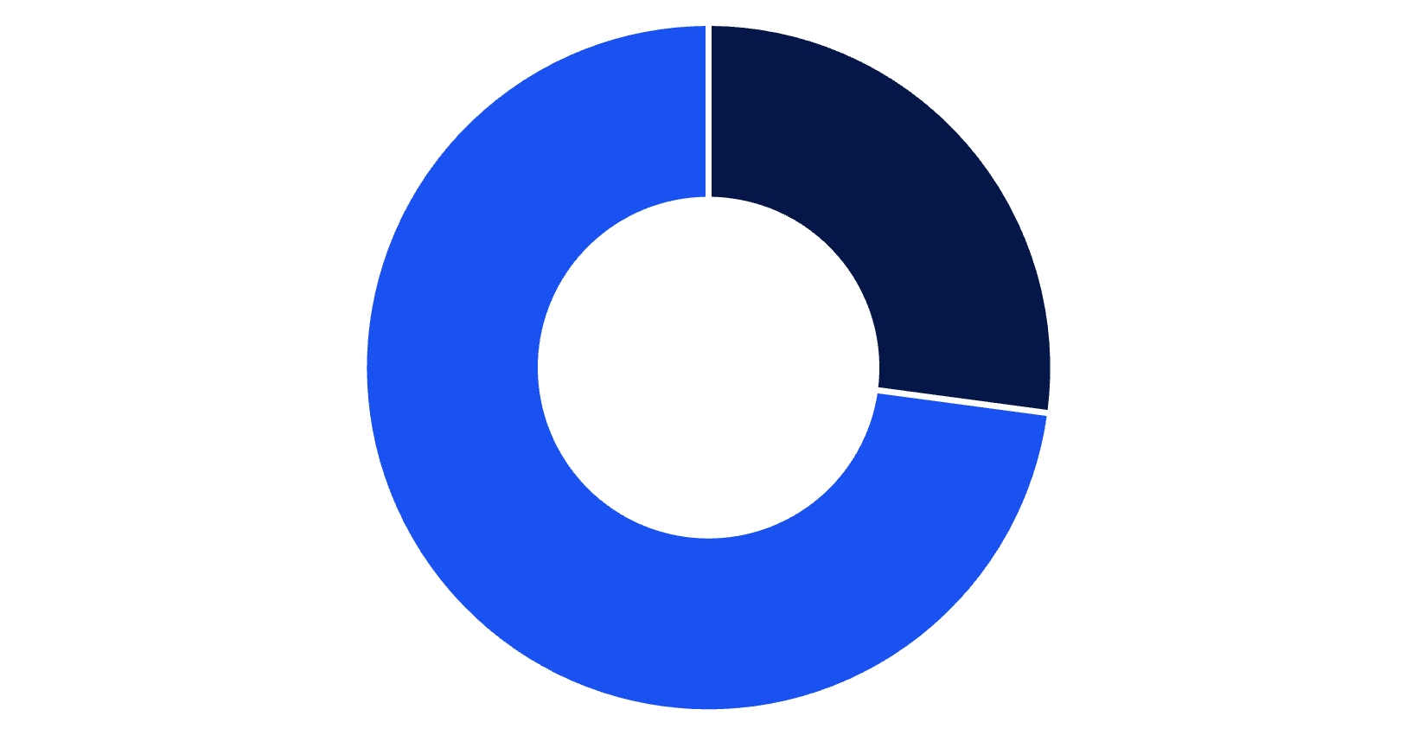
Subscription Analysis
Spending Patterns
$59.49
$59.87
Subscribers
Non-Subscribers
Average spend
Average spend
Minimal spending difference suggests untapped subscription value proposition
Subscribers
Non-Subscribers

Slide 7



CUSTOMER SEGMENTS
Customer Loyalty Breakdown
New
1
83 customers
Returning
2
701 customers
Loyal
3
3,116 customers
Key Finding: 80% of customers are loyal (3+ purchases), with 958 repeat buyers subscribing

Slide 8
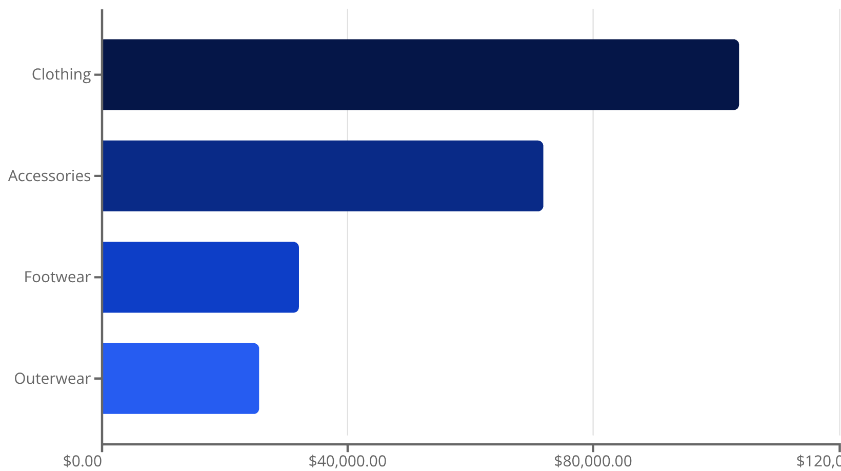
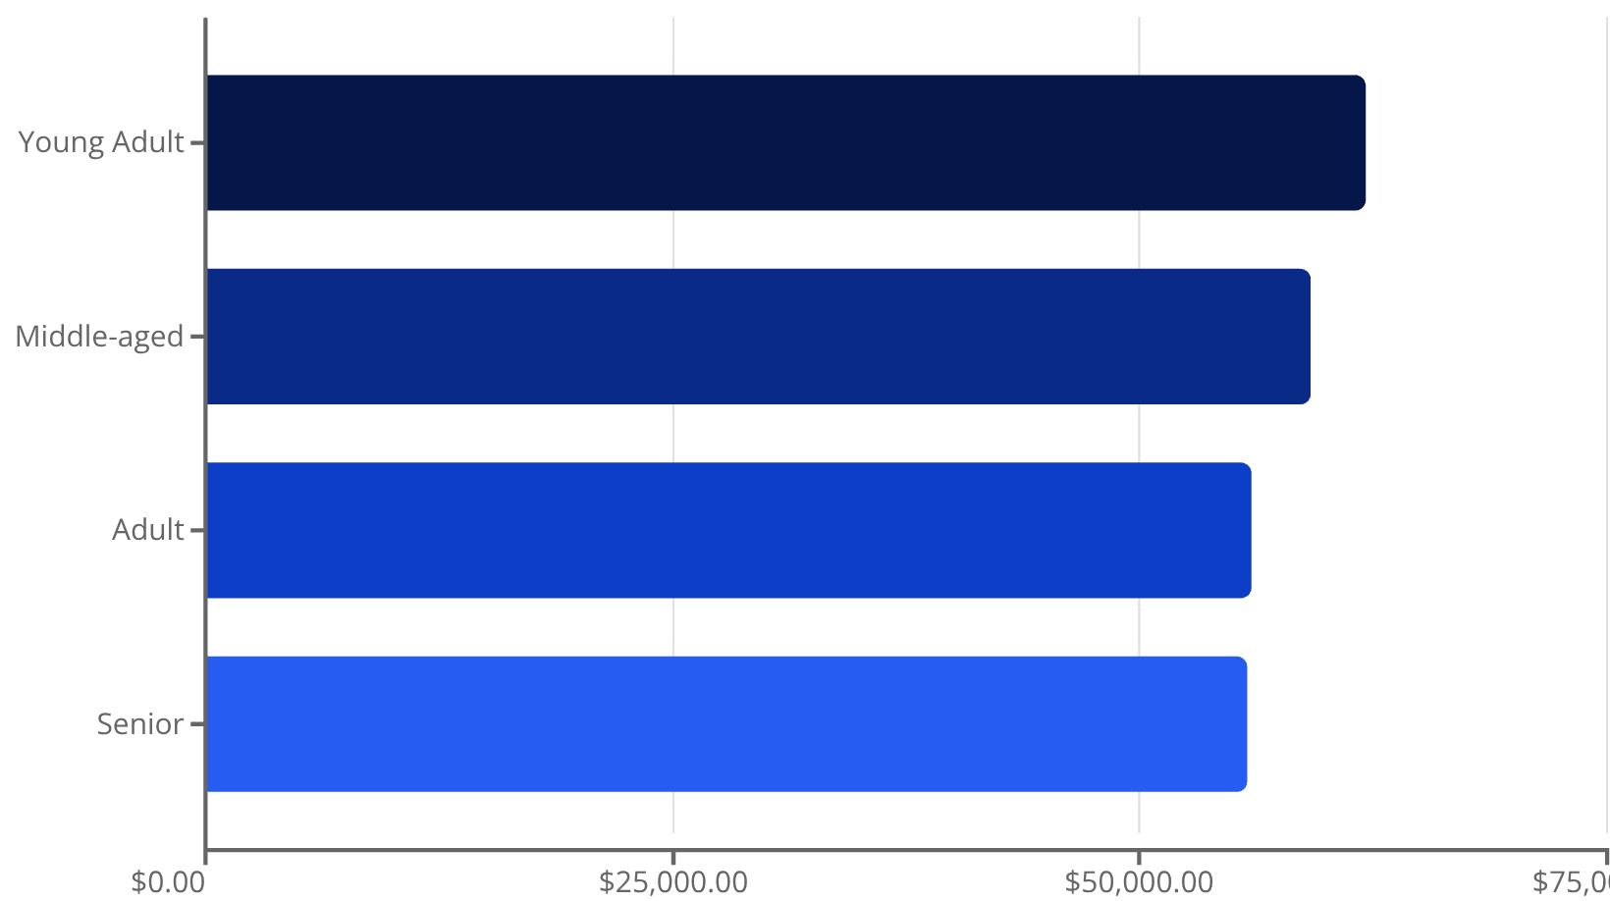
Revenue & Sales Performance
Revenue by Category
Revenue by Age Group
Clothing dominates revenue at $103.7K, while Young Adults lead spending across age groups

Slide 9

POWER BI DASHBOARD
Interactive Visualization
Customer Metrics
3.9K customers tracked with $59.76 average purchase and 3.75 rating
Dynamic Filters
Subscription status, gender, category, and shipping type toggles
Visual Analytics
Revenue and sales breakdowns by category and age group

Slide 10




RECOMMENDATIONS
Strategic Action Plan
Boost Subscriptions
Promote exclusive benefits to convert 73% non-subscribers
Loyalty Programs
Reward repeat buyers to strengthen loyal segment
Review Discounts
Balance sales boosts with margin control
Product Positioning
Highlight top-rated items (Gloves, Sandals, Boots) in campaigns
Targeted Marketing
Focus on Young Adults and express-shipping users for maximum ROI

